Slide 1
CPSC331 - Spring 2019 Tutorial 18
Khobaib Zaamout

Slide 2
Q1: Give pseudocode
Q1: … Describe — and give very brief pseudocode — for another version of the Dpartition algorithm that:
solves this version of the Partitioning problem,
uses a number of steps that is linear in the length r − p + 1 of the subarray being partitioned in the worst case.

Slide 3
Q1: Give pseudocode
Answer: The answer to part i) requires writing the pseudocode of the new algorithm, and establishing its correctness.
The answer to part ii) requires identifying the worst-case running time of the new algorithm.

Slide 4
Q1: Prove that the following holds
Algorithm
int[] DPartition2 (int p, int r)
1. …. T x = A[r]
2. …. int s = p
3. …. int t = p − 1
4. …. int i = p
5. …. while (i < r)
6. …….. T y = A[i]
7. …….. if (y < x)
8. ………… A[i] = A[t + 1]
9. ………… A[t + 1] = A[s]
10. ………… A[s] = y
11. ………… s = s + 1
12. ………… t = t + 1
13. …….. else if (y == x)
14. ………… A[i] = A[t + 1]
15. ………… A[t + 1] = y
16. ………… t = t + 1
17. …….. i = i + 1
18. …. T y = A[t + 1]
19. …. A[t + 1] = x
20. …. t = t + 1
21. …. A[r] = y
22. …. int[] outA = new int[2]
23. …. outA[0] = s
24. …. outA[1] = t
25. …. return outA

Slide 5
Q1: Give pseudocode
Proving the correctness of this new algorithm requires:
Proposing and proving a loop invariant (L03_iterative_correctness.pdf slides #5-28)
Establishing that the algorithm is partially correct (L03_iterative_correctness.pdf slides #29-36)
Establishing and proving a bound function for the algorithm’s loop (L03_iterative_correctness.pdf slides #37-39)
Proving that the algorithm eventually terminates (L03_iterative_correctness.pdf slides #40-43)
*We skip the “proving the correctness” part because it requires more time than allotted for this tutorial.

Slide 6
Q1: Give pseudocode
We show that the algorithm uses a number of steps that is linear in the length r − p + 1 of the subarray being partitioned in the worst case:
Four steps (at lines 1–4) are executed before the while loop is reached, and eight steps (at lines 18–25) are executed after.
During an execution of the body of the while loop either y < x, y = x, or y > x.
In the first of these cases eight steps are executed (at lines 6–12 and 17).
In the second case seven steps are executed (at lines, 6, 7, and 13–17).
In the third case, four steps are executed (at lines 6, 7, 13 and 17).
Thus, at most 8 steps are executed during an execution of the body of the while loop.

Slide 7
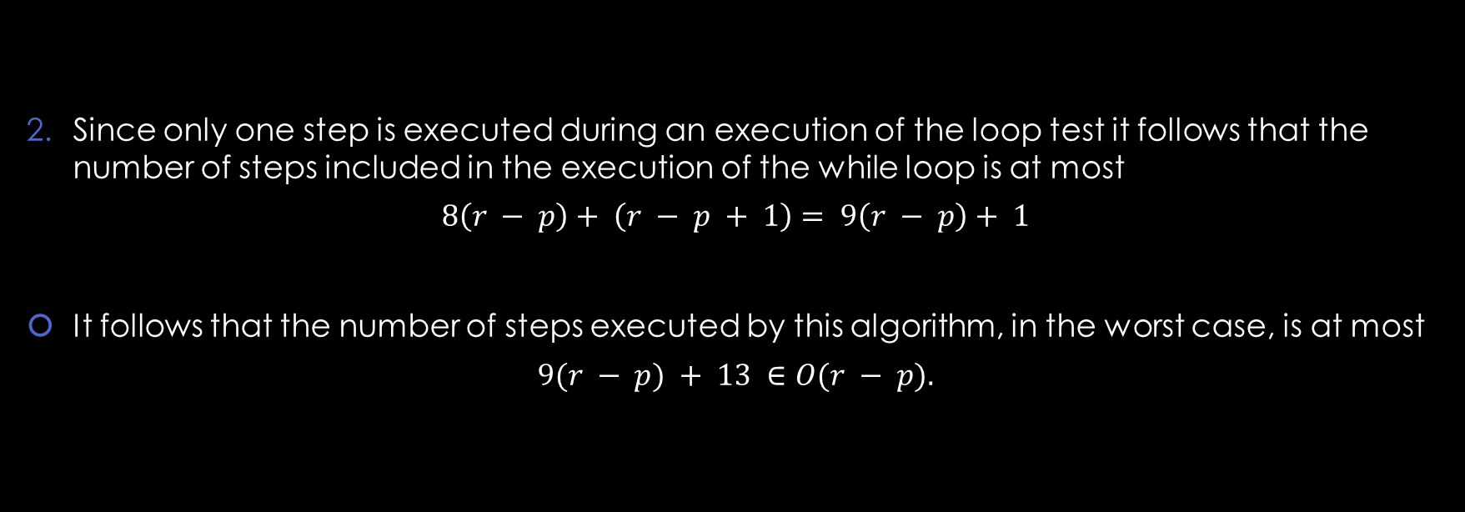
Q1: Give pseudocode
Since only one step is executed during an execution of the loop test it follows that the number of steps included in the execution of the while loop is at most
$$8\left(r − p\right)+ \left(r − p + 1\right)= 9\left(r − p\right)+ 1$$
It follows that the number of steps executed by this algorithm, in the worst case, is at most
$$9(r − p) + 13 ∈O(r − p).$$

Slide 8
Q2: Give pseudocode
Q2:
Give pseudocode for a modified deterministic Quick Sort algorithm that uses the modified partitioning algorithm described in Q1. The number of steps used by this algorithm, when given an array with length n storing n copies of same value as input, should be in O(n).
Sketch a brief proof of the correctness of your algorithm.

Slide 9
Q2: Give pseudocode
void DQuickSort2 (int p, int r)
1. …if (p < r)
2. …int[] split = DPartition2(p, r)
3. …if (p < split[0])
4. ………DQuickSort2(p, split[0] − 1)
5. …if (split[1] < r)
6. ………DQuickSort2(split[1] + 1, r)

Slide 10
Q2: Give pseudocode
Answer:
By inspection of the code, this algorithm has no undocumented side-effects.
In order to prove correctness it therefore suffices to argue that if this algorithm is executed with the preconditions satisfied, then this execution eventually ends and the post conditions satisfied.
This can be proved by mathematical induction on r−p. The strong form of mathematical induction can be used, with the case that p = r (that is, r-p=0) considered in the basis.
Quite a few detailed examples of this kind of proof have been given, by now, and this proof really is very straightforward — so this one will be left as a further exercise.

Slide 11
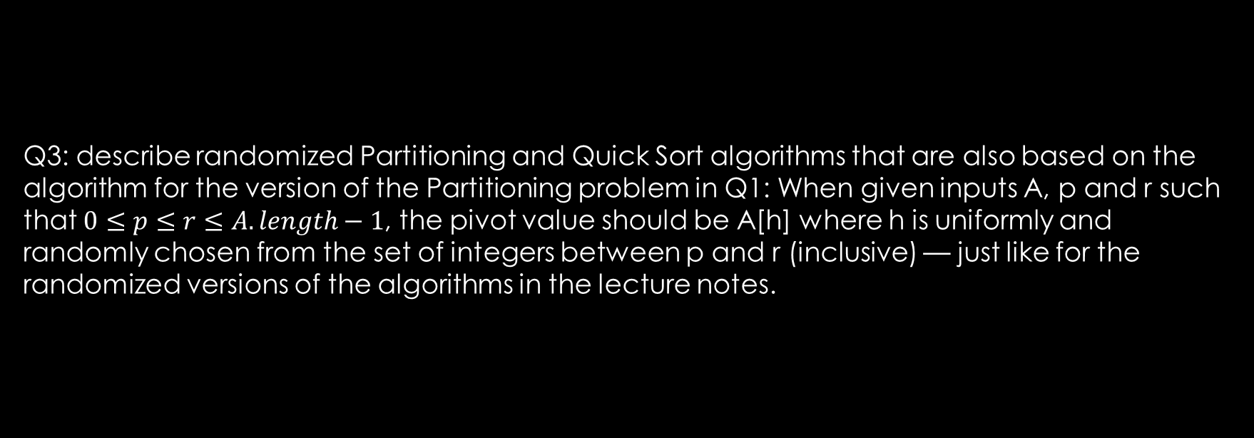
Q3: describe randomized Partitioning
Q3: describe randomized Partitioning and Quick Sort algorithms that are also based on the algorithm for the version of the Partitioning problem in Q1: When given inputs A, p and r such that $0≤p≤r≤A.length−1$, the pivot value should be A[h] where h is uniformly and randomly chosen from the set of integers between p and r (inclusive) — just like for the randomized versions of the algorithms in the lecture notes.

Slide 12
Q3: describe randomized Partitioning
Answer:
The changes needed, to produce a randomized algorithm from the deterministic one, are the same as for the case described in Lecture #19:
The randomized partition algorithm should use a random number generator to choose an integer i uniformly and randomly from the set of integers between p and r, exchange A[i] and A[r], and then apply the deterministic partitioning algorithm.
The randomized Quick Sort algorithm should simply call the randomized partitioning algorithm instead of the deterministic one, and itself recursively instead of the deterministic Quick Sort algorithm.

